Slide 1
Applied Machine Learning and Data Mining
Week 2: Machine learning in the real world: ML Applications
Dr. Alaa Mohasseb

Slide 2
Last Week
Overview of the module content
Introduction to Machine Learning (ML) and Data Mining (DM)
Jupyter Notebook and Python

Slide 3
This Week Learning Objectives
Learn about the History of Machine Learning.
Gain an understanding of the different types of Machine learning algorithms
Identify the different Applications of data mining and Machine Learning in the real world.

Slide 4
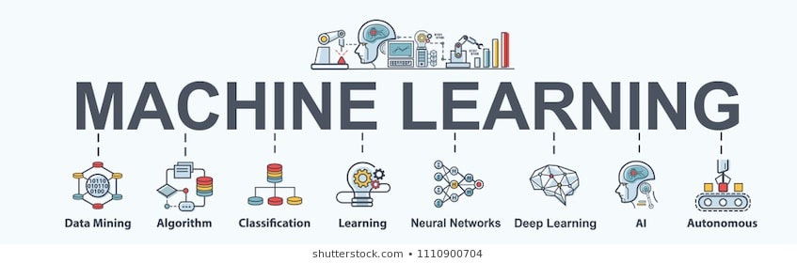

Slide 5
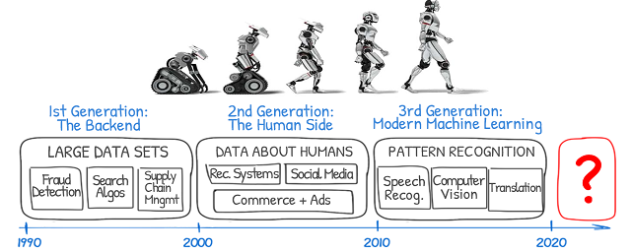
Brief History of Machine Learning
Source: https://medium.com/@ODSC/the-history-and-future-of-ai-with-michael-i-jordan-85f9962ff139

Slide 6
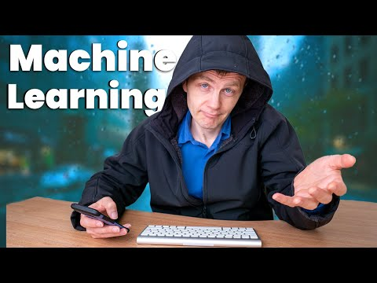
History of Machine Learning

Slide 7
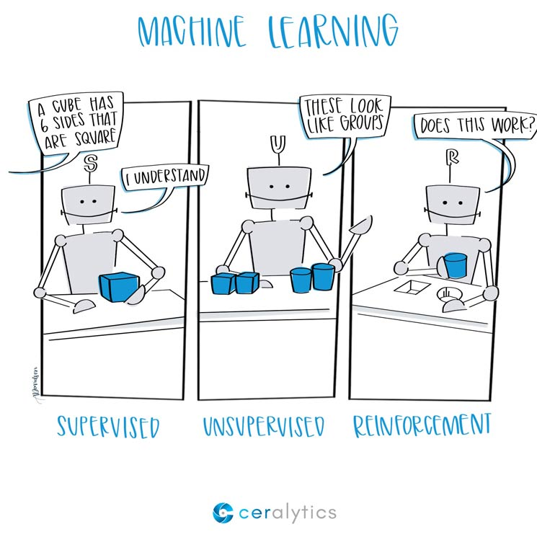
Types of Learning Algorithms
Supervised Learning: Supervised learning is a type of machine learning where the algorithm is trained on a labeled dataset, meaning that the input data is paired with the correct output. The goal of supervised learning is to learn a mapping from input to output so that the algorithm can make predictions or classifications on new, unseen data
Unsupervised Learning: Unsupervised learning, in contrast, deals with unlabeled data, meaning there is no predefined output for the algorithm to learn from. Instead, the algorithm seeks to find patterns, structures, or relationships in the data without explicit guidance. This can involve clustering similar data points together or reducing the dimensionality of the data.
Reinforcement learning is a type of machine learning where an agent learns to make a sequence of decisions by interacting with an environment. It's inspired by behavioral psychology and is often used to solve problems where an agent needs to learn a series of actions that maximize a cumulative reward.
There are several types of learning algorithm. There are three main types that we will focus on in this module:
Supervised Learning
Unsupervised
Reinforcement Learning
Source: https://www.ceralytics.com/3-types-of-machine-learning/
Notes:
Labeled vs. Unlabeled Data:
Supervised learning uses labeled data with known outputs.
Unsupervised learning uses unlabeled data with no predefined outputs.

Slide 8
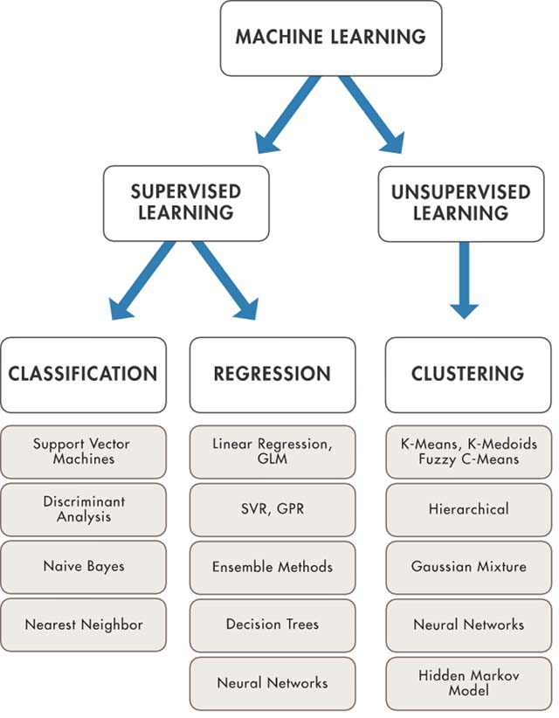
Supervised vs Unsupervised
In this module the focus will be on the following:
Supervised Learning
Classification
Regression
Unsupervised Learning
Clustering
Association Rules
Source: https://ecmapping.com/technews/wp-content/uploads/2018/02/the-10-machine-learning-algorithms-to-master-for-beginners-pic2.jpg

Slide 9
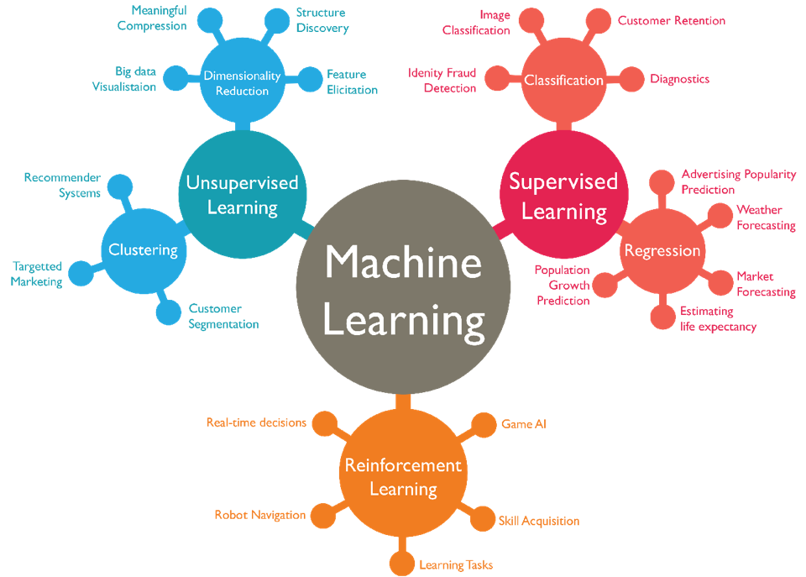
Example
Source: https://favpng.com/png_view/machine-learning-statistical-classification-supervised-learning-artificial-intelligence-png/j5cevXcY

Slide 10
ML in real World
DM/ML Applications

Slide 11



Data Mining and Machine Learning Applications
Healthcare
Retail
Education
E-Commerce
Travel
Media & Entertainment
Finance
Telecom

Slide 12
Healthcare
Diseases Identification and Diagnosis
Personalised Medicine / Treatment
Drug Discovery and Manufacturing
Smart Health Records
Medical Imaging
Disease Prediction

Slide 13
Finance
Consumer Analytics
Security
Fraud Detection
Process Automation
Risk Analysis

Slide 14
Retail
Recommendation Systems
Customer Sentiment Analysis
Price Optimisation
Personalised Marketing

Slide 15
Day-to-day Learning Applications
Search Engine
Google Lens
Chat Bot
Google Assistant, Siri and Alexa

Slide 16

Search Engine
Search engine such as Google uses Machine learning.
Every search the engine uses the keywords in the searches, with those keywords, it shows the different web pages.
Search engine uses search history to improve its search engine. It aims to provide even better search results after every search.
Source: https://853239.smushcdn.com/1831098/wp-content/uploads/2019/10/search-engines.png?lossy=1&strip=1&webp=1

Slide 17
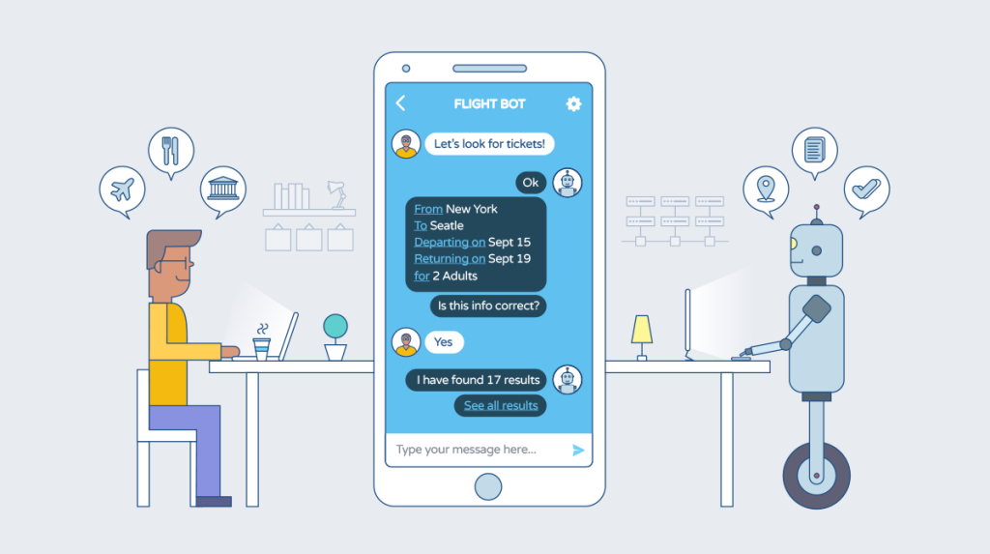
Chat Bot
Chatbots serve in various customer service platforms such as flight-booking sites to assist customers.
Chatbots are trained models.
The training data includes specific questions and keywords.
Source: https://medium.com/swlh/chatbots-of-the-future-86b5bf762bb4

Slide 18
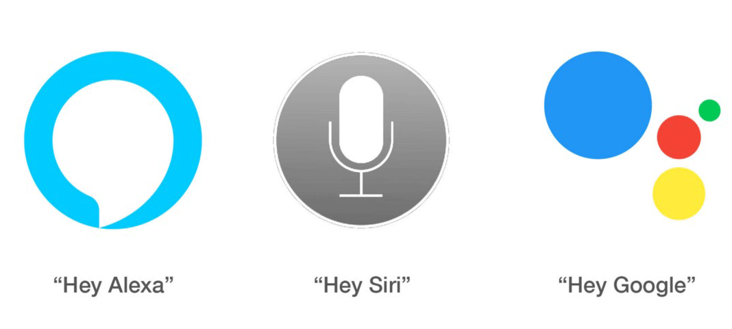
Siri and Alexa
These three are the prime examples of ML on smartphones.
They are assistants based on speech and text recognition.
They work by using voice command to navigate through the internet or mobile functions.
Source: https://babyconnect.files.wordpress.com/2019/03/hey2.gif

Slide 19
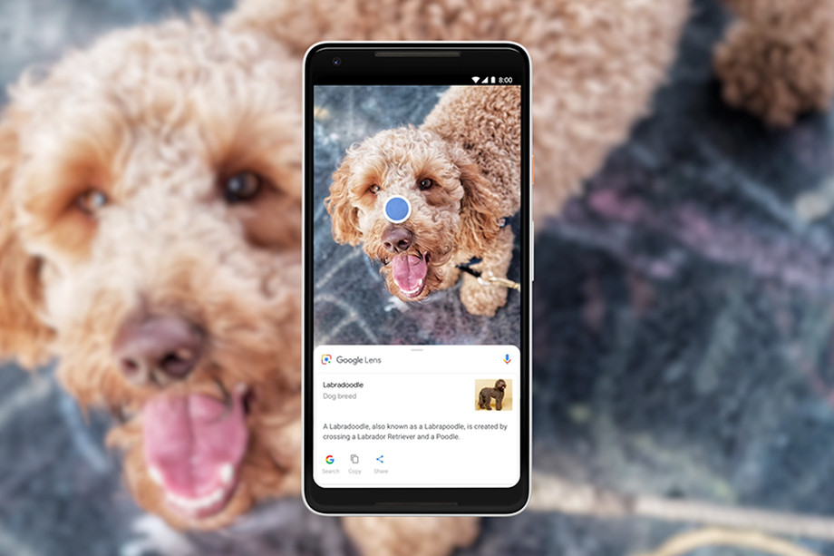
Google Lens
In the smartphone camera, there is a feature of the Google Lens. It directly connects the camera to the internet.
Google Lens uses image recognition.
Source: https://cdn.vox-cdn.com/thumbor/AIccqydQQn5ncnWIgou95pvzYgw=/0x0:1000x563/920x613/filters:focal(420x202:580x362)/cdn.vox-cdn.com/uploads/chorus_image/image/59702773/google_lens_dog_1.0.png

Slide 20
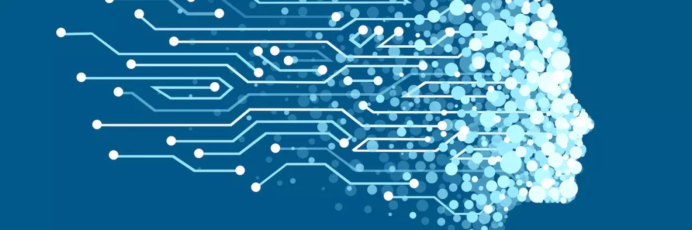
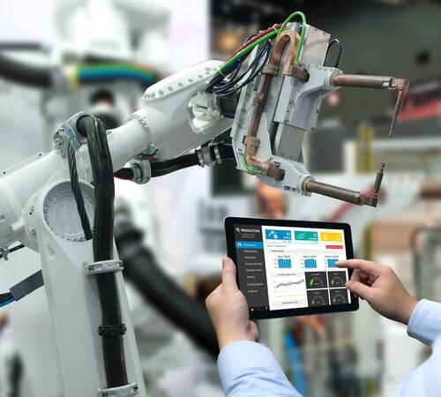

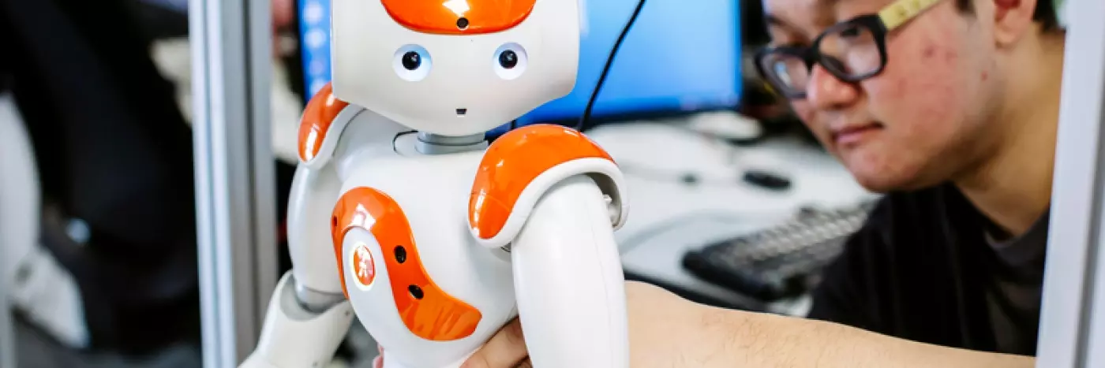
AI and Machine Learning at University of Portsmouth and School of Computing
Cluster in Artificial Intelligence and its Practical Applications (AIPA)
Computational intelligence research group

Slide 21
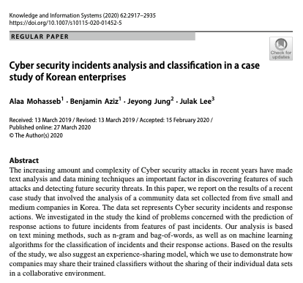
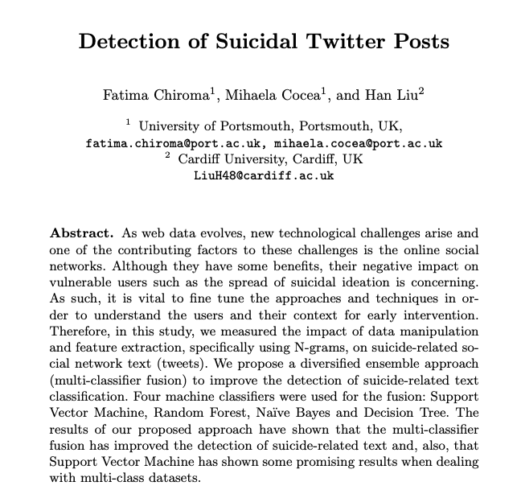
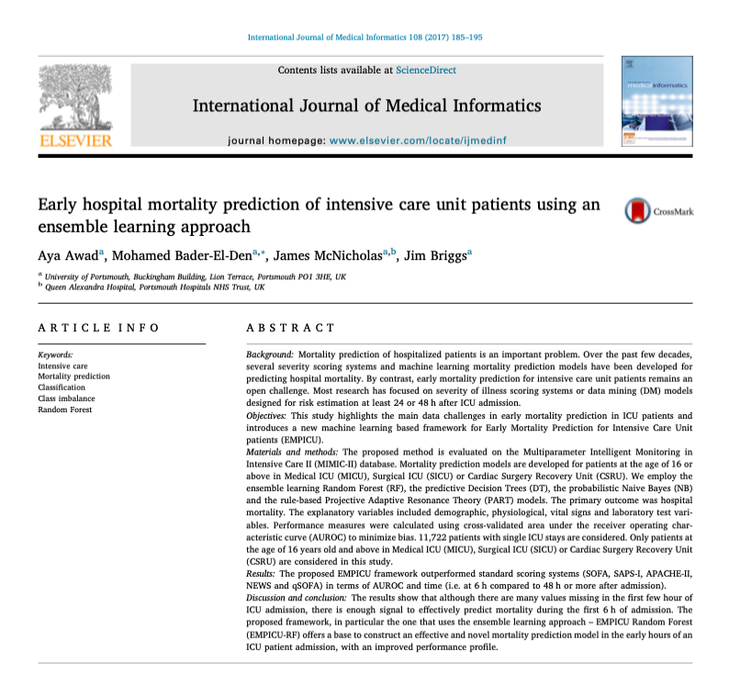
Real-World Machine Learning Based Research

Slide 22
Papers References
Detection of Suicidal Twitter Posts
Cyber security incidents analysis and classification in a case study of Korean enterprises
Early hospital mortality prediction of intensive care unit patients using an ensemble learning approach

Slide 23
Reading for the Week
https://www.cretech.com/wp-content/uploads/2018/12/Ai-mi-by-jennifer-conway-1.pdf
https://www.colocationamerica.com/blog/machine-learning-basics
https://codete.com/blog/machine-learning-in-healthcare/
https://innovecs.com/blog/machine-learning-in-healthcare/
https://www.n-ix.com/machine-learning-in-finance-why-what-how/

